Slide 1
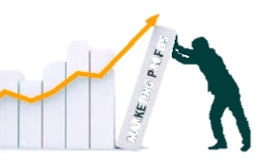
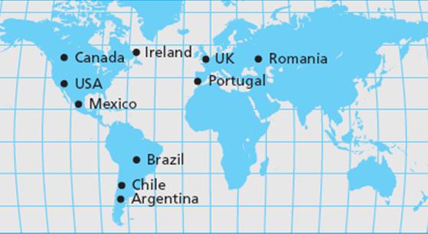

Building a Marketing Plan
MBM6
Chapter 14
Stericycle is the world’s largest
medical waste recycler.
Chapter 14 Objectives
The Process of Building a Marketing Plan
Step I: Situation Analysis
Step II: Marketing Strategy
Step III: Performance Plan
2011 Worldwide Market Demand $11 billion
We will use Stericycle to illustrate the process of building a marketing plan. * Go www,Stericycle.com to learn more about this company, and service products.
Copyright Roger J. Best, 2012

Slide 2
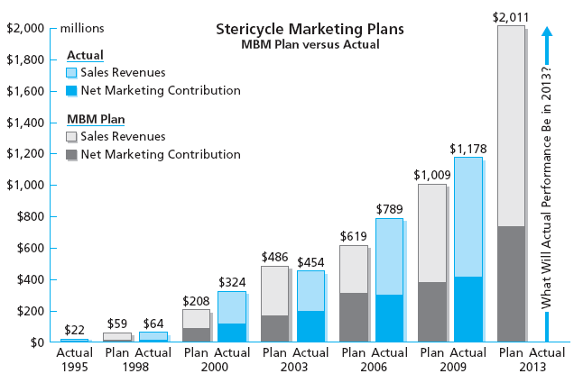
MBM Sample Marketing Plan
Number 6
MBM6
Chapter 14
Performance Exceeded Plan in Most Years
Each edition of MBM a 3-year Stericycle Sample Marketing Plan was published. The Plan vs. Actual results are shown above,
Copyright Roger J. Best, 2012

Slide 3
Building a Marketing Plan
MBM6
Chapter 14
The Process of Building a Marketing Plan
This section outlines the benefits of a marketing plan.
Copyright Roger J. Best, 2012

Slide 4

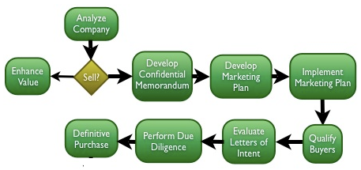

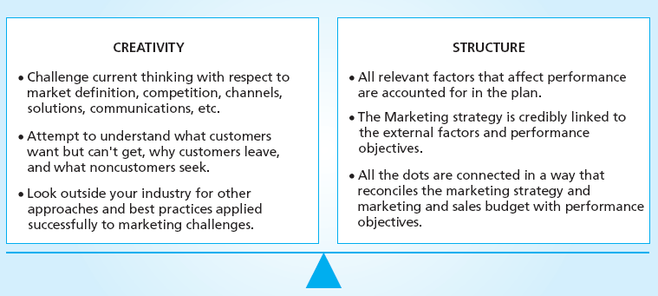
Both Are Needed…Why?
MBM6
Chapter 14
CREATIVITY
STRUCTURE
Challenge current thinking and convention assumptions.
Strive to go deeper into the total customer experience.
Look outside your industry for new ideas and best practices.
Comprehensive - Includes all important performance factors.
Logical – Connects all the dots linking strategy to performance
Performance Roadmap as to cost and expected performance.
Copyright Roger J. Best, 2012

Slide 5

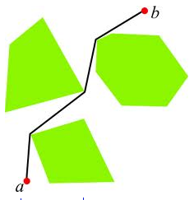
A Marketing Plan Is a Roadmap
MBM6
Chapter 14
Going From Point A to Point B
Where Are We and Where Do We Want to Go?
- We are at Point A and want to go to Point B.
- There is not a clear path to Point B. - We have limited resources in getting to Point B.
How Do We Want to Get There?
- We developed the route shown.
- Take advantage of opportunities & lessens threats
- It is achieveable with available resources.
What Is Suppose to Happen When We Get There?
Arrive on time with no major surprises or set-backs
Enjoy the expected benefits of Point B
Stayed within the planned budget.
Copyright Roger J. Best, 2012

Slide 6



Three Major Steps in Building a Marketing Plan
MBM6
Chapter 14
STEP 1: SITUATION ANLAYSIS
Where Are We Now?
Customer Experience
STEP 2: MARKETING STRATEGY
How Do We Get Where We Want To Go?
Strategic
Choices
STEP 3: PERFORMANCE PLAN
Can We Achieve Our Desired Results?
Desired
Results
Copyright Roger J. Best, 2012

Slide 7
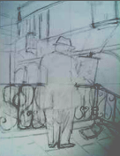


Painting a Picture vs. Building a Marketing Plan
MBM6
Chapter 14
Situation Analysis
Painting Strategy
Desired Outcome
Your strategy for taking the current situation to a desired outcome.
Your representation of the current situation.
What you hope to achieve with your painting strategy.
What Are the Similarities In Painting this Picture and Building a Marketing Plan?
Copyright Roger J. Best, 2012

Slide 8
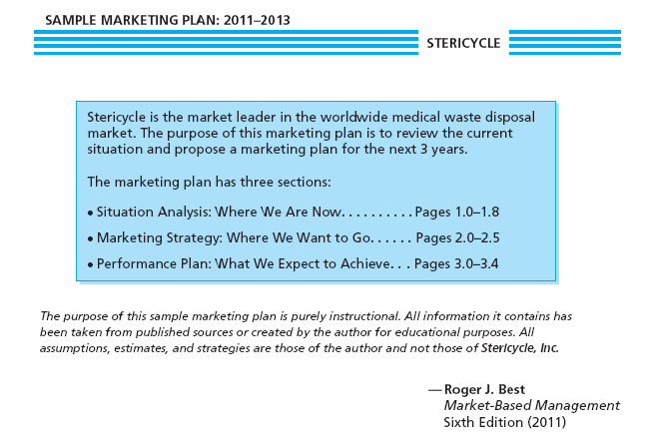
Stericycle – Sample Marketing Plan
MBM6
Chapter 14
Marketing Plan Outline
Copyright Roger J. Best, 2012
Copyright Roger J. Best, 2011

Slide 9
Building a Marketing Plan
MBM6
Chapter 14
Step 1: Situation Analysis
This section presents the elements of a current situation.
Copyright Roger J. Best, 2012

Slide 10
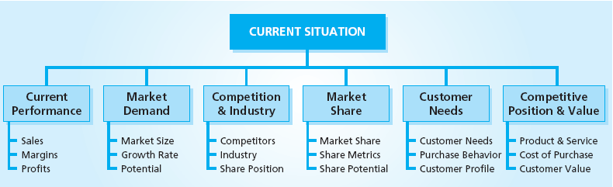

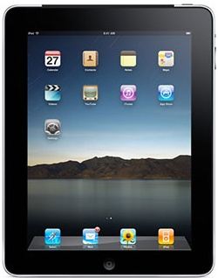
Current Situation: Major Considerations
MBM6
Chapter 14
How is the Current Situation different for the Apple Mac vs. the Apple iPad?
Copyright Roger J. Best, 2012

Slide 11
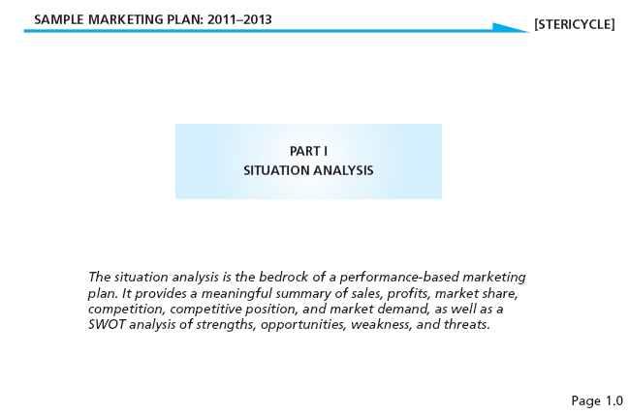
Where Are We Now?
MBM6
Chapter 14
Situation Analysis – Where Are We?
Copyright Roger J. Best, 2012

Slide 12
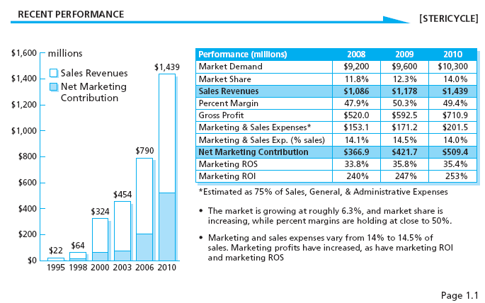
Situation Analysis: Recent Performance
MBM6
Chapter 14
Where Have We Been?
Copyright Roger J. Best, 2012

Slide 13
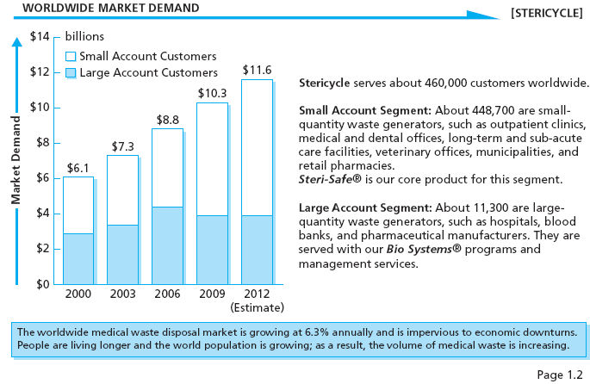
Situation Analysis: Market Demand
MBM6
Chapter 14
Where Is the Market Going?
Copyright Roger J. Best, 2012

Slide 14
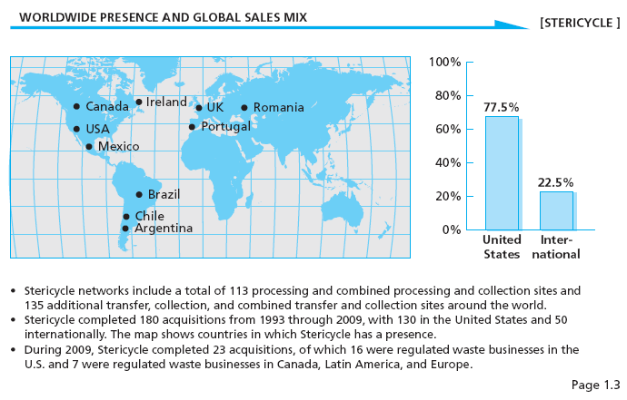
Situation Analysis: Global Sales Mix
MBM6
Chapter 14
What Are The Markets We Serve?
Copyright Roger J. Best, 2012

Slide 15
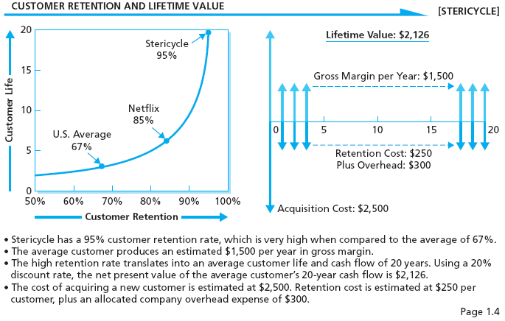
Situation Analysis: Customer Lifetime Value
MBM6
Chapter 14
How Profitable Are Customers?
Copyright Roger J. Best, 2012

Slide 16
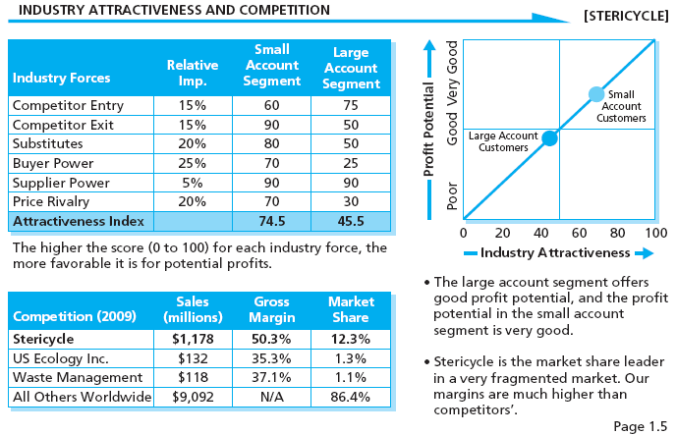
Situation Analysis: Industry Analysis
MBM6
Chapter 14
Are We In An Attractive Industry?
Copyright Roger J. Best, 2012

Slide 17
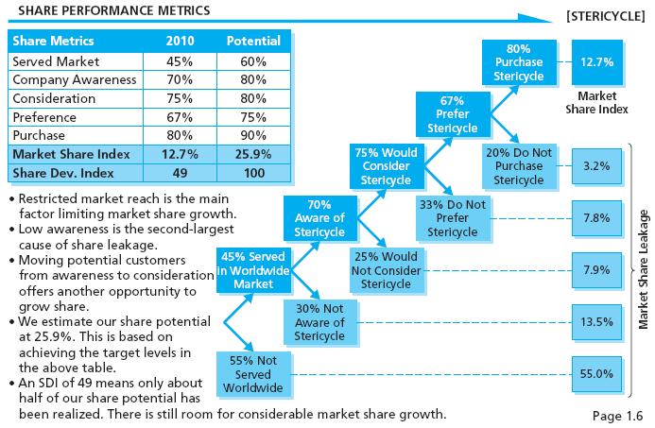
Situation Analysis:
Share Performance Metrics
MBM6
Chapter 14
Where Is Our Share Leakage?
Copyright Roger J. Best, 2012

Slide 18
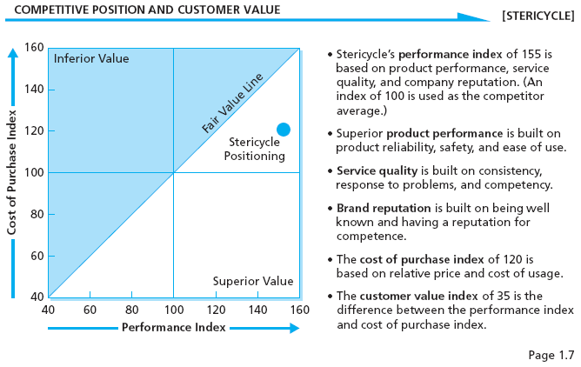
Situation Analysis: Competitive Position
MBM6
Chapter 14
Are We Strong Competitively?
Copyright Roger J. Best, 2012

Slide 19
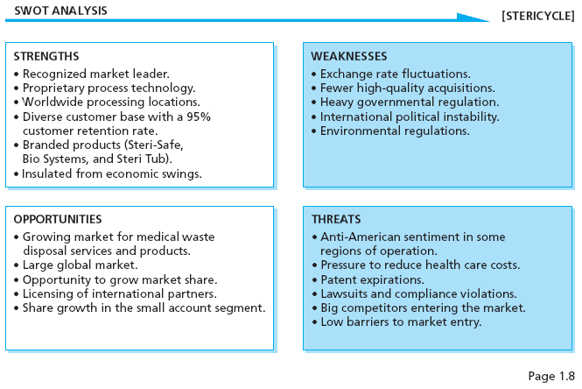
Situation Analysis: SWOT Analysis
MBM6
Chapter 14
Where Should We Focus?
Copyright Roger J. Best, 2012

Slide 20
Building a Marketing Plan
MBM6
Chapter 14
Step 2: Marketing Strategy
This section presents the Marketing Strategy portion of a Marketing Plan.
Copyright Roger J. Best, 2012

Slide 21
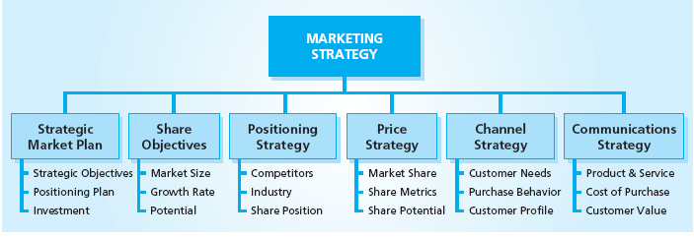
Marketing Strategy: Major Considerations
MBM6
Chapter 14
How is the Marketing Strategy different for the Apple Mac vs. the Apple iPad?
Copyright Roger J. Best, 2012

Slide 22
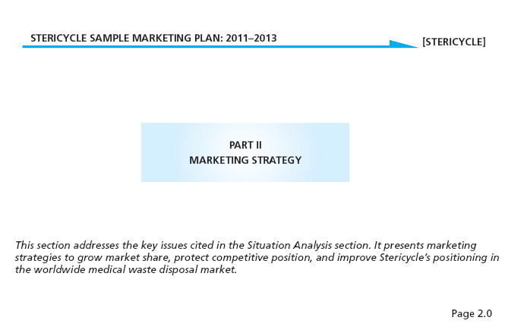
How Do We Achieve Our Goals?
MBM6
Chapter 14
What Is Our Strategic Path?
Copyright Roger J. Best, 2012

Slide 23
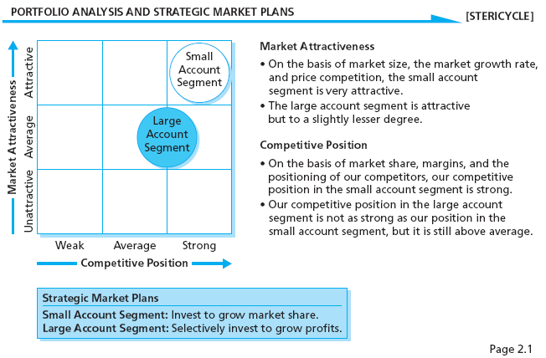
Portfolio Analysis
MBM6
Chapter 14
What Is Our Portfolio Position?
Copyright Roger J. Best, 2012

Slide 24
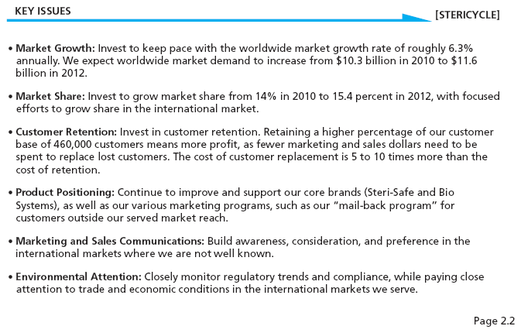
Prioritizing Key Issues
MBM6
Chapter 14
What Are Our Strategic Priorities?
Copyright Roger J. Best, 2012

Slide 25
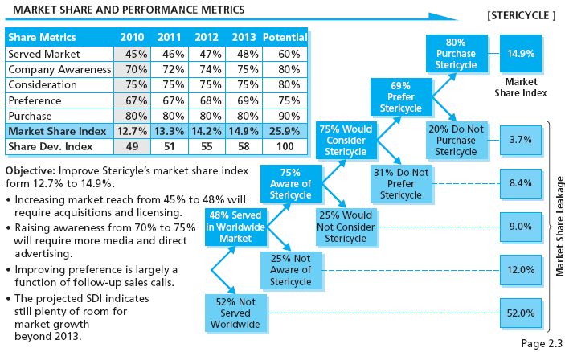
Market Share Strategy
MBM6
Chapter 14
Market Share Performance Objectives
Copyright Roger J. Best, 2012

Slide 26
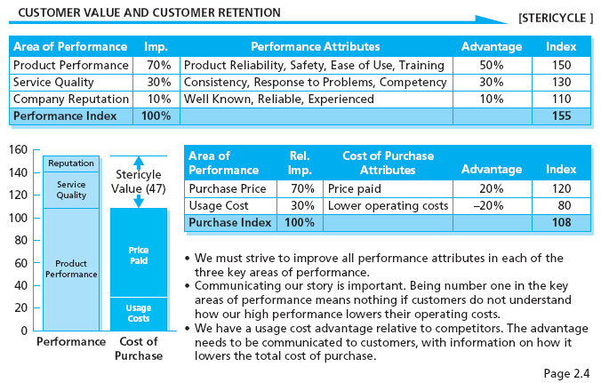
Positioning Strategy
MBM6
Chapter 14
What Is Our Value Proposition?
Copyright Roger J. Best, 2012

Slide 27
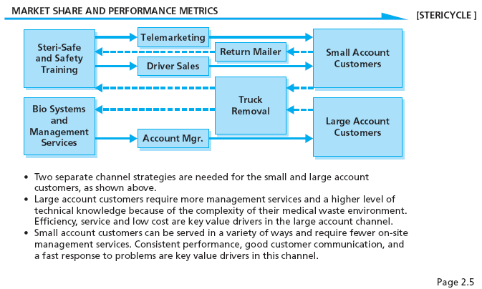
Channel Strategy
MBM6
Chapter 14
What Is Our Channel Strategy?
Copyright Roger J. Best, 2012

Slide 28
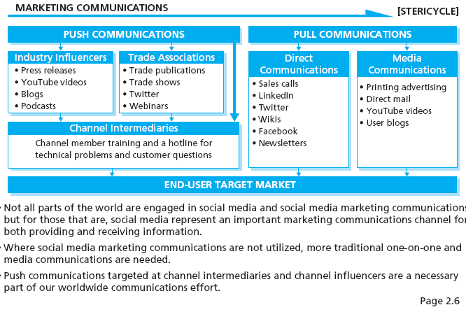
Communications Strategy
MBM6
Chapter 14
What Is Our Communications Strategy?
Copyright Roger J. Best, 2012

Slide 29
Building a Marketing Plan
MBM6
Chapter 14
Step 3: Performance Plan
This section presents the Planned Performance portion of a Marketing Plan.
Copyright Roger J. Best, 2012

Slide 30
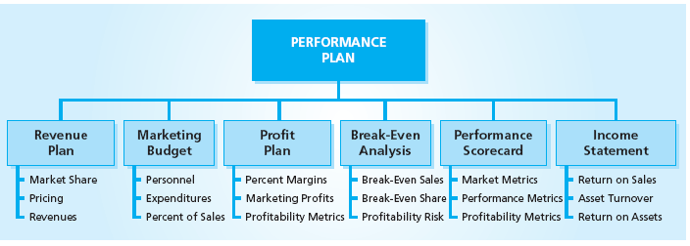
Performance Plan: Major Considerations
MBM6
Chapter 14
How is the Marketing Strategy different for the Apple Mac vs. the Apple iPad?
Copyright Roger J. Best, 2012

Slide 31
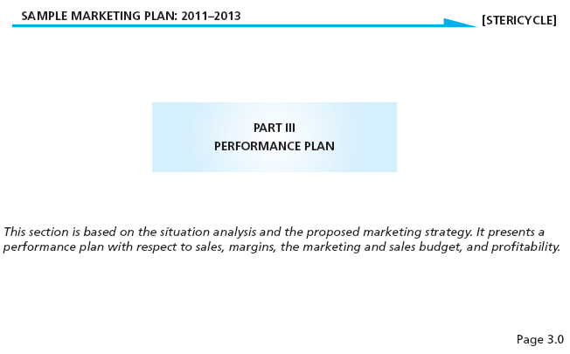
Performance Plan
MBM6
Chapter 14
What Is Our Performance Plan?
Copyright Roger J. Best, 2012

Slide 32
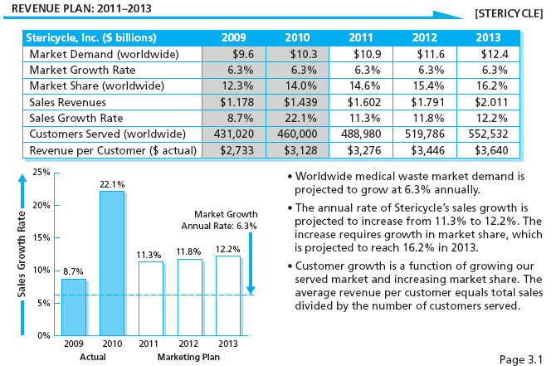
Revenue Plan
Marketing Performance Tool 14.2
Where Are Revenues in 3 Years?
Copyright Roger J. Best, 2012

Slide 33
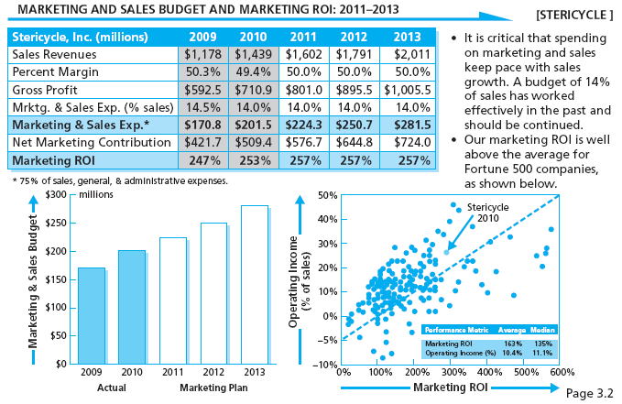
Marketing & Sales Budget
MBM6
Chapter 14
What Is Our Investment in Mktg. & Sales?
Copyright Roger J. Best, 2012

Slide 34
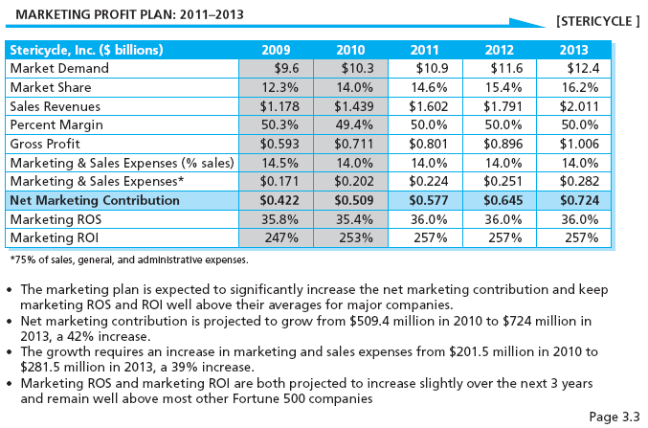
Marketing Profit Plan
Marketing Performance Tool 14.1
How Are Profits Expected to Grow?
Copyright Roger J. Best, 2012

Slide 35
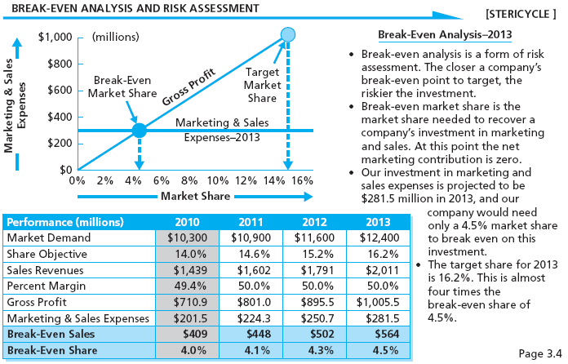
Breakeven Analysis
MBM6
Chapter 14
How Much Risk Is in This Investment?
Copyright Roger J. Best, 2012

Slide 36
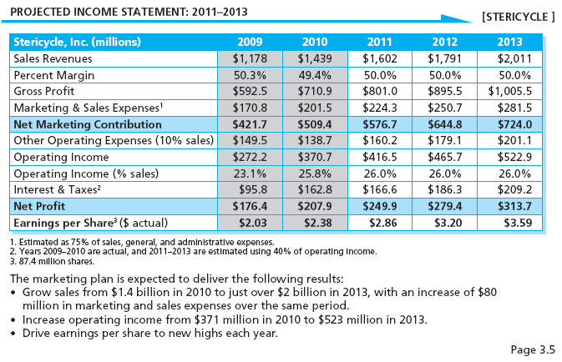
Income Statement & Share Price
MBM6
Chapter 14
What Is Our Expected Income in 3 Years?
Copyright Roger J. Best, 2012

Slide 37
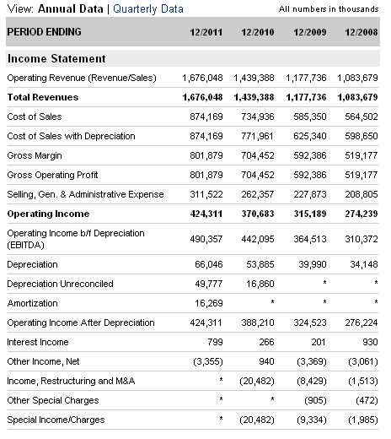
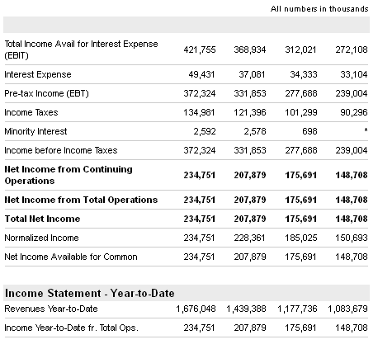

Slide 38
